Slide 1
The DATA SCIENCE PROCESS: A Report On Credit One Scoring Service
Presented By: Papyss Ntoukap

Slide 2


The Data Science Process: Definition
Involves extracting insights from vast amounts of data
Use various scientific methods, algorithms, and processes to extract data information
Helps to discover hidden patterns from the raw data
Helps to provide an answer to the business question behind the data

Slide 3
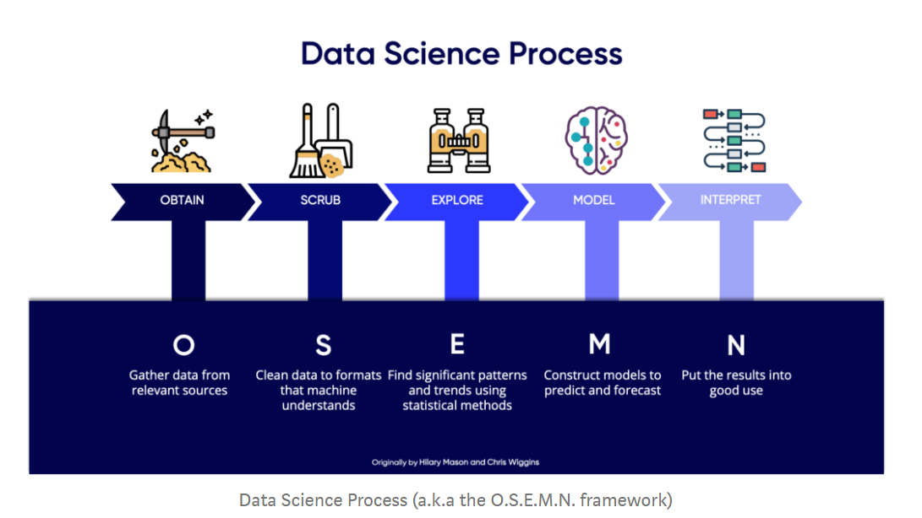
The Data Science Process: Definition (continued)
Encompasses five steps known under the acronym called “The O.S.E.M.N” Framework:

Slide 4
The Data Science Process: The Business Question
Credit One’s is looking for a much better way to understand at the very least, if a customer should be approved or not, and how much credit to allow to each customer
The intent underlying the question is the increase in the number of defaulted loans granted to customers, and the derived likely risk of losing business if the problem persists
The business consideration is to analyzing at the very least, factors to be used in the loan approval process, the amount of credit to allow to each customer
The analysis will rely on Credit One’s historical credit scoring data extracted from its database, and will consist of determining the possibilities of solving the increase of customer defaulted loans

Slide 5
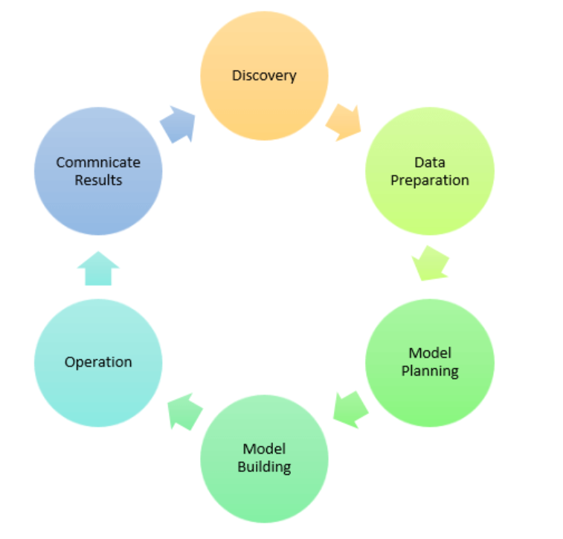
The Data Science Process: Analysis Plan
What is the Analysis Goal?
The analysis goal derives from an iterative process as described in the graph below, and consists of using the Machine Learning model to draw insights from historical data on each customer credit score analysis and the amount of loan granted to individual customer in order to predict the future trend of loan reimbursements and maintain the business

Slide 6
The Data Science Process: Analysis Plan (Continued)
What Hypotheses are to be Tested?
Analyzing how and if the credit scoring process of customers is carried out by Credit One to determine:
The basis of the loan approval decision concerning each customer
The basis of the loan amount granted to each customer
The reason of the defaulted loans and the increase in number of defaulted loans
What Data is Required/Available to Test the Hypotheses?
Knowledge of Credit One’s historical credit score data and other customers physical/personal characteristics (age, gender, education level, marital status)
NOTE: For a comprehensive analysis and an insightful answer to the business question, Credit One’s data present some limitations, including: The customers income status, housing status (homeowner or renter?), and debt status and any other expenses driving factors (extra alimonies)

Slide 7
The Data Science Process: Analysis Plan (Continued)
What Methodology(ies) Will You Employ?
Define the predicted variable referring to the business question to answer, and the independent variables (training and testing the data)
Model will be trained and validated
Based on business context, the best model will be adopted
Use the Machine Learning to build the model (a linear regression aims at predicting the quantitative response) based on historical data values – single feature (input variable or predictor)
What is the Project Plan (Timeline and Milestones, Risks, Phasing, Prioritization, …)?
Considering the iterative process of the data science analysis, any poor or unexpected outcome at any step of the process might trigger a review of the previous steps and can cause the process to be re-executed on a regular basis depending on the gravity of the business problem

Slide 8
The Data Science Process: Data Collection
From Where Can the Data be Obtained? How Must the Data be Cleansed and Validated?
Involve three steps:
Data Selection: As an external client storing its data in a MySQL database, Credit One’s data will be obtained from its database using a structured query language or sql to query to database table and retrieving the data into a pandas dataframe
Data Preprocessing: Organizing the above selected data by formatting, scrubbing (cleaning and filtering), sampling from it, and explore the data
Data transformation: Use scaling, attribute decomposition, and attribute aggregation to convert the preprocessed data above to be ready for machine learning – Data Modeling (distributes datasets for training and testing)

Slide 9
The Data Science Process: Insights
Patterns in the Data
Data will be analyzed to find any existing correlation between variables, null values, duplicated values, etc.
Analysis of Hypothesis
The results obtained from each hypothesis analysis will be verified observed to see if they provide or not (proven or disproven?) an accurate answer that addresses the business question
Ranking of the Results
The quantified impact of the finding will be ranked based on the result of each of the hypothesis
Level of Confidence of the Results
Each result will enable and determine the level of confidence to place on each hypothesis result by stakeholders

Slide 10
The Data Science Process: Recommendation
Consider the variety of the audience and their technical and non- technical knowledge concerning their understanding of the project presentation
Avoid the use of technical words, or define them if used
Recall the project purpose/scope and the underlying business question to address
Present the methodology and any technical tools used to solve the problem and address the question
Present the analysis result and any key insights or takeaways from the derived result
Provide any recommendation useful for addressing any such future business problem

